Slide 1
Roomba An Extensible Framework to Validate and Build Dataset Profiles
Ahmad Assaf, Raphaël Troncy And Aline Senart

Slide 2
Data Profiling
Data profiling is the process of creating descriptive information and collect statistics about that data. It is a cardinal activity when facing an unfamiliar dataset [Kimball et al. 98, Manyika et al. 13]
Profiles reflect the importance of datasets without the need for detailed inspection of the raw data
Profiles are presented as a set of metadata available in formats e.g. JSON, RDF, XML
Roomba - An Extensible Framework to Validate and Build Dataset Profiles

Slide 3
Profiling Tasks
Statistical Profiling
Metadata Profiling
Topical Profiling
Metadata provisioning is one of the Linked Data publishing best practices
The ability to automatically check this metadata helps in:
Delaying data entropy (degradation on information content in raw or metadata)
Enhancing data discovery, exploration and reuse
Enhancing spam detection for data portal administrators
Roomba - An Extensible Framework to Validate and Build Dataset Profiles

Slide 4
Related Work
Flemming’s data quality assessment tool✝ Provides metadata assessment based on manual user input
ODI certificate✝✝ provides descriptions of the published data quality in plain English based on an extensive survey filled by the publisher
Project Open Data Dashboard✝✝✝ tracks and measures how US governments implements Open Data principles
The Datahub Validator✝✝✝✝ gives an overview of data sources cataloged on the datahub
✝ http://linkeddata.informatik.hu-berlin.de/LDSrcAss/datenquelle.php
✝✝ https://certificates.theodi.org/
✝✝✝ http://labs.data.gov/dashboard/
✝✝✝✝ http://validator.lod-cloud.net/
Roomba - An Extensible Framework to Validate and Build Dataset Profiles

Slide 5
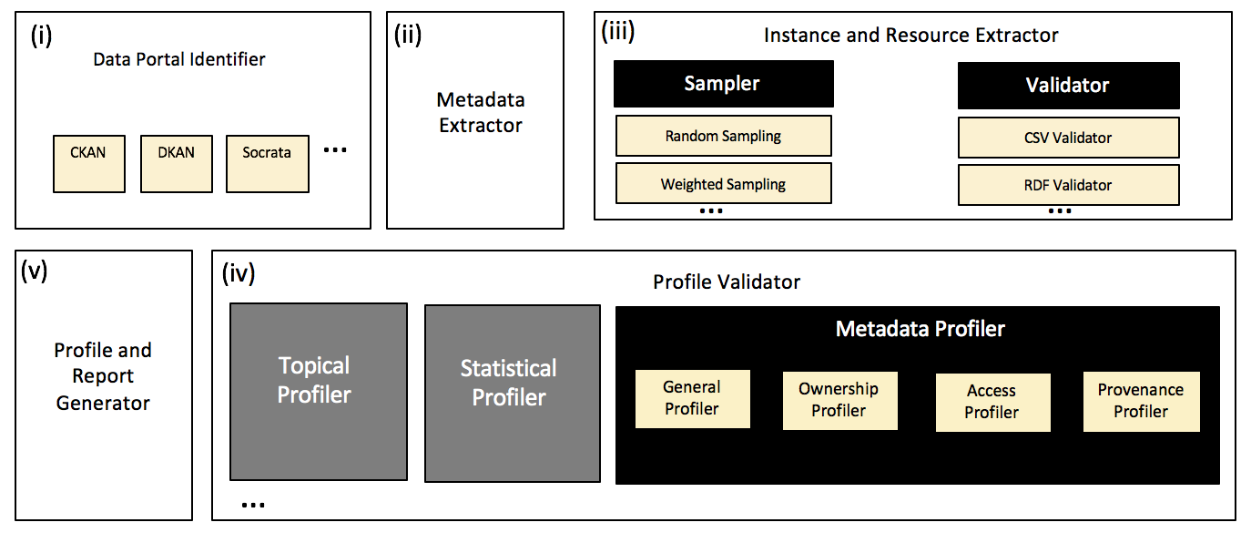
Our Proposal
Roomba addresses the challenges of automatic validation and generation of descriptive dataset profiles
https://github.com/ahmadassaf/opendata-checker/
Roomba - An Extensible Framework to Validate and Build Dataset Profiles

Slide 6
i) Data Portal Identification
Roomba is extensible to any data portal exposing its functionalities via an external accessible API
This process is important in order to identify the underlying data model
We apply various methods for the portal identification process:
URL inspection
Meta tags inspection
Document Object Model (DOM) inspection
API query
Roomba - An Extensible Framework to Validate and Build Dataset Profiles

Slide 7
ii) Metadata Extraction
Roomba currently supports CKAN-based data portals
We divided the metadata information into four main types
Roomba - An Extensible Framework to Validate and Build Dataset Profiles

Slide 8
iii) Instance and Resource Extraction
The metadata should contain information about the resources associated with the dataset
Before extracting the resource instance(s), Roomba performs:
Resource metadata validation: Checking the HTTP request HEAD information
Format Validation: Validate resource formats against a linter or a validator e.g. node-csv for CSV files or n3 for N3 and Turtle RDF serializations
Roomba - An Extensible Framework to Validate and Build Dataset Profiles

Slide 9
iv) Instance and Resource Extraction - Sampling
Certain datasets contain large amounts of resources.
A sampler method is introduced to execute various strategies:
Random Sampling: Randomly select resources
Weighted Sampling: resource datatype properties over the maximum number of datatype properties of all dataset resources.
Resource Centrality Sampling: resource types over the total number of resources types in the dataset
Roomba - An Extensible Framework to Validate and Build Dataset Profiles

Slide 10
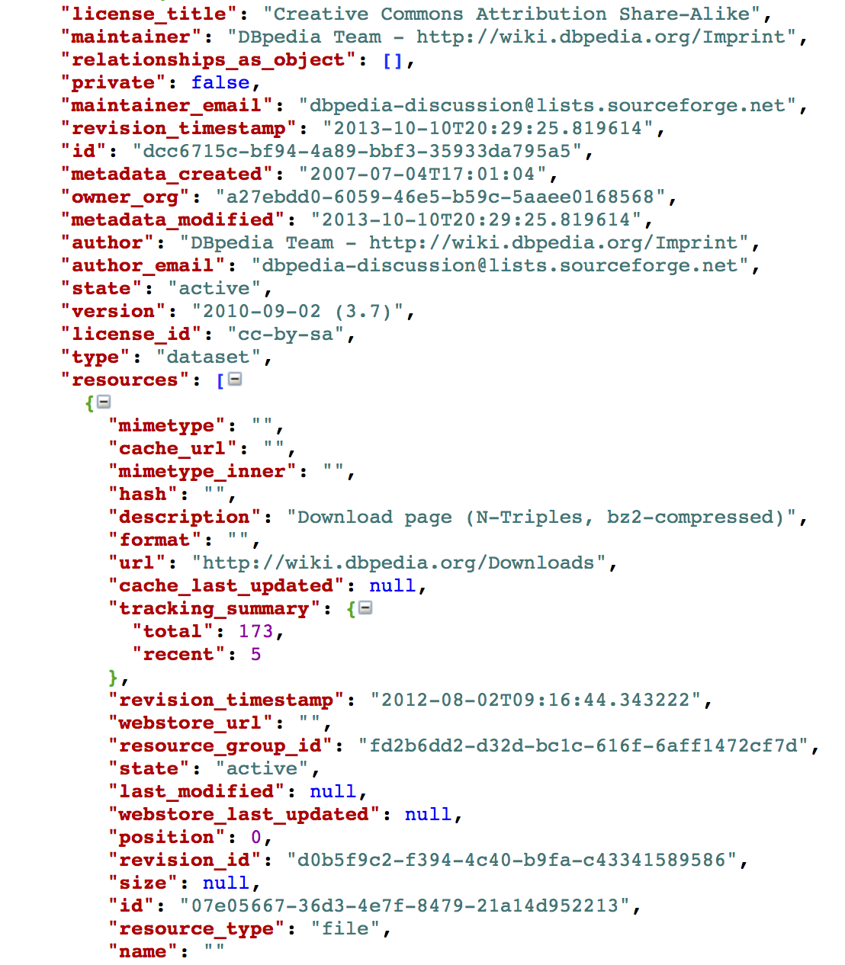
v) Metadata Validation
The validation process identifies missing or incorrect information and tries to automatically correct them when possible.
The validation is measured against the standard dataset model of the underlying data portal
There exist special validation steps for some fields e.g. emails, urls
We use the HTTP request header information to fix various fields automatically
Roomba - An Extensible Framework to Validate and Build Dataset Profiles

Slide 11
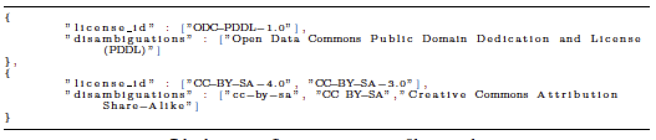
Metadata Validation – License Information
From our experiments, license information were particularly noisy and not standardized e.g. CCZero, CC0
We manually created a license mappings✝ file standardizing the license ID, title and url from the Open Licenses knowledge base
✝ https://github.com/ahmadassaf/opendata-checker/blob/master/util/licenseMappings.json
Roomba - An Extensible Framework to Validate and Build Dataset Profiles

Slide 12
Manual Reporting
Data portal administrators need an overall knowledge of the datasets and their properties
Roomba allows generation of numerous reports driven by manually entered formatted queries
Meta-field aggrgation values e.g. resources>resource_type
Key:object meta-field values: resources>resource_type:resources>name
Empty field values
Roomba - An Extensible Framework to Validate and Build Dataset Profiles

Slide 13
vi) Profile and Report Generation

Slide 15
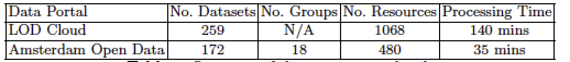
Experiments & Evaluation
We ran Roomba on two CKAN-based data portals (datahub.io, data.amsterdamopendata.nl)
LOD cloud currently contains 1014 datasets harvested via LDSpider Crawler, however the datahub contains only 259 datasets tagged with “lodcloud” and returned by the CKAN API
We focus on measuring two main aspects: Profiling correctness and completeness
Roomba - An Extensible Framework to Validate and Build Dataset Profiles

Slide 16
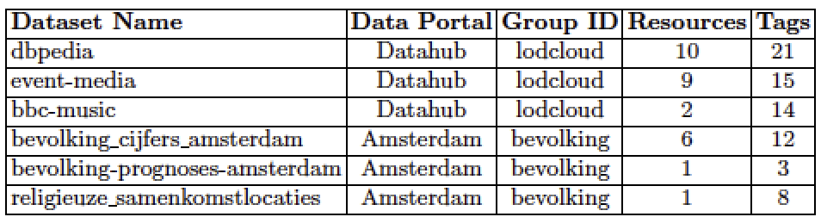
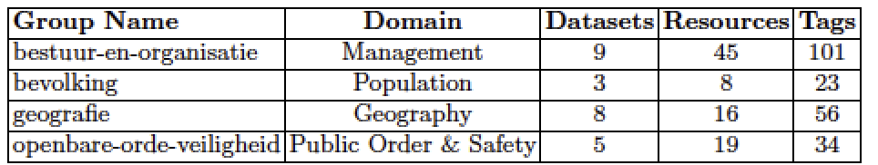
Experiments & Evaluation – Profiling Correctness
Roomba - An Extensible Framework to Validate and Build Dataset Profiles

Slide 17
Experiments & Evaluation – Profiling Completeness
To analyze the completeness, we manually constructed a synthetic set of profiles
The profiles cover the range of uncommon problems that occur in a certain dataset:
Incorrect resources mimtype or size
Invalid number of tags or resources
Correct normalization of license information
Syntactically invalid emails and urls
https://github.com/ahmadassaf/opendata-checker/tree/master/test
Roomba - An Extensible Framework to Validate and Build Dataset Profiles

Slide 18
Conclusion & Future Work
Issues surrounding metadata quality affect directly dataset search in data portals
Roomba enables automatic validation, correction and creation of dataset profiles especially when combined with statistical and topical profilers
We plan to introduce workflows to enable the correction of the rest of the metadata through intuitive, manually-driven interfaces
We also plan to support other data management systems like DKAN and Socrata
Various other enhancements e.g. scheduled reporting
Roomba - An Extensible Framework to Validate and Build Dataset Profiles

Slide 19
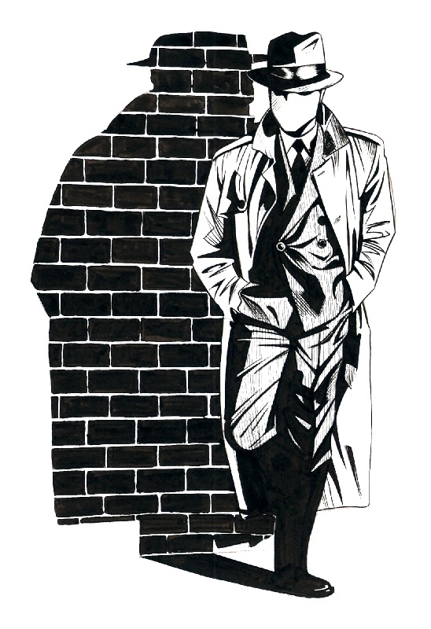
seek, and ye shall find
Questions?
Ahmad Assaf
http://ahmadassaf.com
@ahmadaassaf
http://github.com/ahmadassaf
HDL Towards a Harmonized Dataset Model for Open Data Portals

